Slide 1
Augmenting Network Automation with AI: From RAG to MCP
06-JAN-2026

Slide 2
Agenda
Lecture - RAG Labs - RAG Break Lecture – MCP
Labs - MCP
06-JAN-2026

Slide 3
Lab Requirements
You will need:
Git
Python 3.9, 3.10 or 3.11
PyATS requires Python of one of these version
If you are using Windows:
you will need Windows Subsytems for Linux (WSL)
Recommend using Ubuntu from the Microsoft Store
The full instructions for the lab can be found here:
automateyournetwork/NANON96_Workshop: From RAG to MCP

Slide 4
Lab Requirements
We will be using the Cisco DevNet Always On IOS-XE Sandbox
You will receive (or should have received) and e-mail with the information required
You should also have received an openAI API key provided by John to use for the labs

Slide 5
RAG Lecture Agenda
Introductions and Lab Setup
The Stages of AI
1.0 - GUI / API
1.5 - RAG
2.0 - Agents
RAG
6 Step Process
Embeddings (vectors)
Storage
Retrieval

Slide 6
RAG Lecture Agenda
RAG-Fusion
Multi-Query
Reciprocal Ranking
RAPTOR
Spine-leaf ?
graphRAG
Knowledge Graphs
TAG
tables

Slide 7
RAG Lecture Agenda
RAFT
Fine-Tuning
Agents using RAG / RAG using Agents
Agentic RAG
Tool Selection

Slide 8
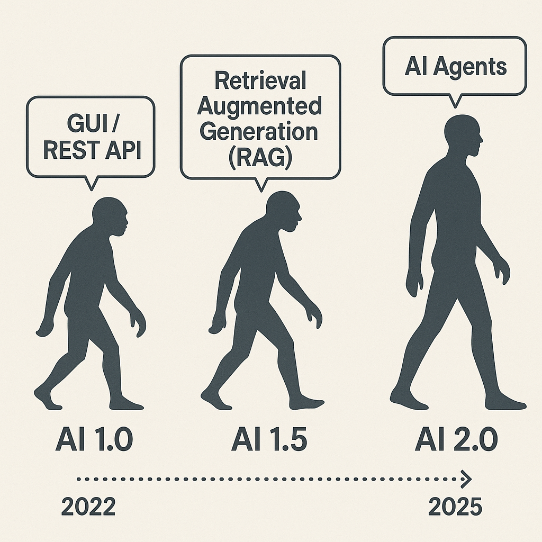

Slide 9
AI 1.0 - GUI / REST API
The beginning of modern AI integration into workflows. Interfaces were built around graphical user interfaces (GUI) and REST APIs. Systems were reactive, rule-based, and required precise inputs.
Characteristics:
Manual interactions via UI
Predefined API endpoints
No contextual understanding
Automation limited to basic scripting

Slide 10
AI 1.5 - Retrieval Approaches
A leap in capability with large language models able to retrieve and reason over external data. Systems began to offer contextual responses grounded in current or proprietary knowledge.
Characteristics:
Combines LLMs with external data sources
Supports context-aware Q&A
Introduces knowledge grounding
Still linear, not autonomous

Slide 11
AI 2.0 - ReACT Agents (Agentic AI)
The emergence of autonomous, goal-driven agents capable of planning, reasoning, and taking actions across multiple tools. Systems evolve from stateless prompts to stateful workflows.
Characteristics:
Task orchestration and tool use
Memory and planning
Multi-step reasoning
Autonomous execution across APIs, files, and platforms

Slide 12
6 Steps of Retrieval Augmented Generation

Slide 13
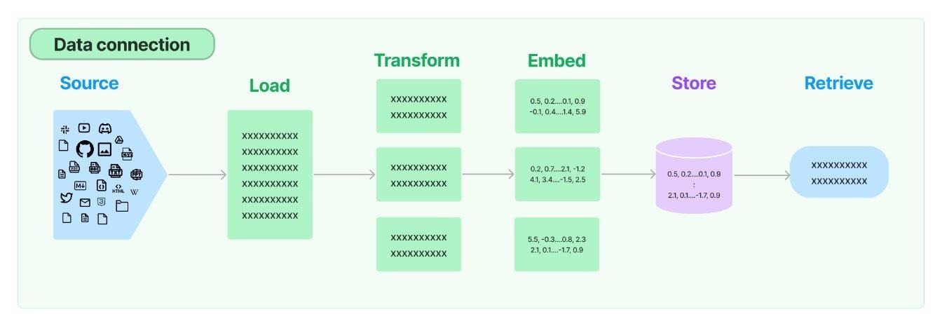

Slide 14
1 - Source
The source of the external knowledge you want to augment the generation of output.
High level categories:
Webpages
PDFs
Cloud Providers
Social Platforms
Messaging Services
Productivity Tools
Common File Types

Slide 15
2 - Load
Once you have a source you need to find the appropriate loader. Sample code to load a JSON file:
from langchain_community.document_loaders import JSONLoader
file_path='./sample.json' loader = JSONLoader( file_path=file_path, jq_schema='.quiz', text_content=False)
docs = loader.load() print(docs[0].page_content[:100]) print(docs[0].metadata) For all loaders: Document loaders | 🦜️🔗 LangChain
document_loaders — 🦜🔗 LangChain documentation

Slide 16
3 – Split (Transform)
A semantic splitter breaks text into chunks based on meaning, not just size or structure. It uses LLMs or embeddings to find natural boundaries—like a shift in topic, tone, or idea—rather than blindly splitting by paragraphs, headers, or token limits.
📘 Example: Network Engineering Manual
Imagine you're using RAG on a 50-page Cisco IOS XE config guide.
Naive splitter: Splits every 500 tokens. This might:
Split a show ip interface brief explanation halfway.
Mix unrelated topics like BGP and EIGRP in the same chunk.
Semantic splitter: Analyzes where the concept changes and chunks accordingly:
One chunk for show ip interface brief
Another for configure static routing
Another for EIGRP authentication
This ensures each chunk is coherent, self-contained, and relevant to a single question.

Slide 17
3 – Split (Transform)
A note on splitting - we are entering a bit of a recursive inception like dependency on Artificial Intelligence models being used to improve the outcomes from further models downstream
To wit; an embeddings model is used to semantically chunk the data that is then transformed with an embeddings model into vectors (embeddings) (next step) and then a large language model can perform semantic lookups from the user prompt against the vectors (embeddings) (to be explained later)
Idea being its turtles all the way down .. use AI to help AI outcomes

Slide 18
4 – Embed (Vectors)
Embedding models transform human language into a format that machines can understand and compare with speed and accuracy. These models take text as input and produce a fixed-length array of numbers, a numerical fingerprint of the text's semantic meaning. Embeddings allow search system to find relevant documents not just based on keyword matches, but on semantic understanding.
Input: "How do I configure BGP authentication?"
Output: [0.12, -0.87, 0.45, ..., 0.33] ← fixed-length vector
Similar vectors → semantically similar content

Slide 19
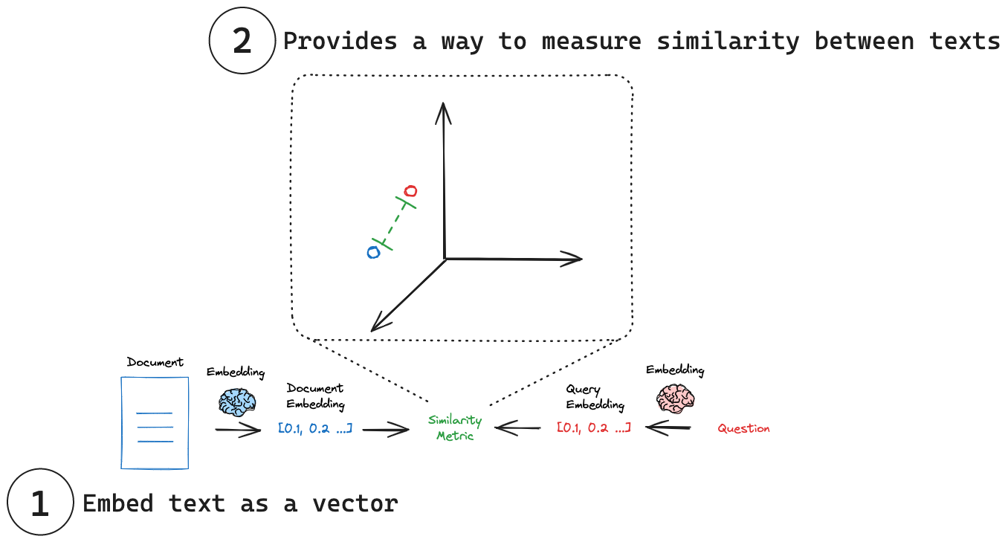

Slide 20
5 – Store
Now that we have lists of floating point numbers, the vectors, we need to store them either in memory or in a database (or both). This database is optimized for storing and searching embeddings (numerical vectors). Enabling fast similarity search to retrieve relevant documents based on semantic meaning.
ChromaDB, FAISS, Weaviate, Pinecone, Elastic, Qdrant, Milvus
We will be using ChromDB, locally, privately, for our labs
I also really like Elastic because you get the “ELK” (Elastic, Logstash, Kibana) stack - meaning you can visualize and inspect much easier

Slide 21
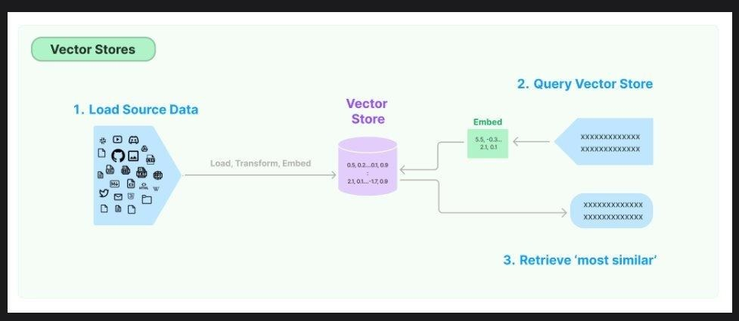
6 - Retrieve
Finally the Large Language Model (LLM) gets involved in the process and the prompt is transformed into vectors and a similarity search is performed between the prompt and the vector store returning the closest vectors to augment the generation of output.

Slide 22
Before we move on – Questions about RAG?

Slide 23
RAG: Multi-Query

Slide 24
People Ask Stupid Questions!
Can we take the users original question and derive +n number of similar questions
Similar or different in:
Tone
Sentiment
Word selection
Sophistication
Technical accuracy
We can use AI to generate additional, similar, prompts to help AI generate the best possible answer to the original prompt

Slide 25
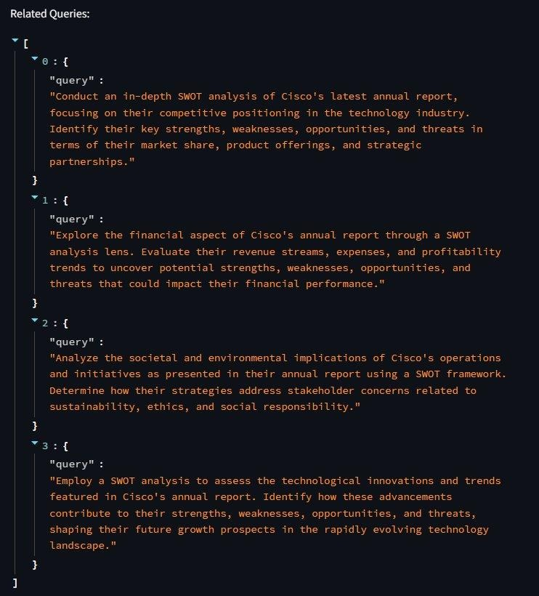


Slide 26
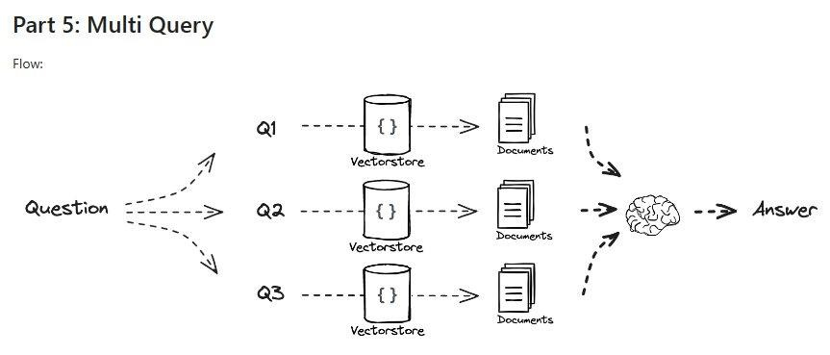
rag-from-scratch/rag_from_scratch_5_to_9.ipynb at main · langchain-ai/rag-from-scratch · GitHub

Slide 27
RAG Fusion

Slide 28
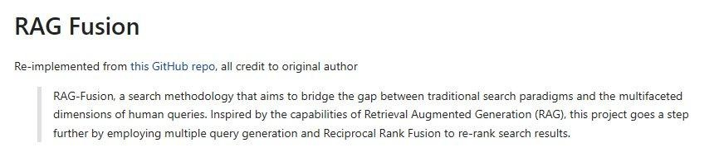
Reciprocal ReRanking
langchain/cookbook/rag_fusion.ipynb at master · langchain-ai/langchain · GitHub​

Slide 29
Synthetic Answers
Going a step further we can use reciprocal ranking and other methods to evaluate and rank the 'best' answers
We can take 'all' answers and synthesize a 'best' answer
We can round-robin against multi-LLM to get different 'perspectives' and generations; and synthesize a multi-LLM council of answers
We can bounce the initial answers from all LLMs against all other LLMs and come to a consensus of the 'best' answer (and throw away outlying hallucinations

Slide 30
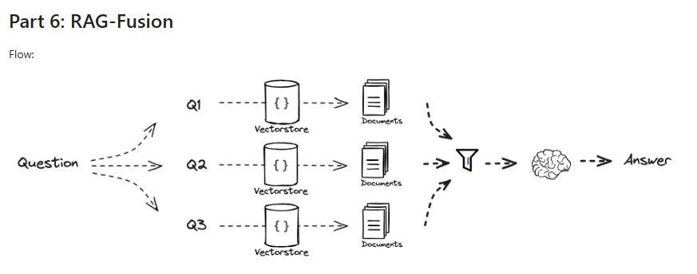
rag-from-scratch/rag_from_scratch_5_to_9.ipynb at main · langchain-ai/rag-from-scratch · GitHub

Slide 31
RAPTOR: Recursive Abstractive Processing for Tree-Organized Retrieval

Slide 32
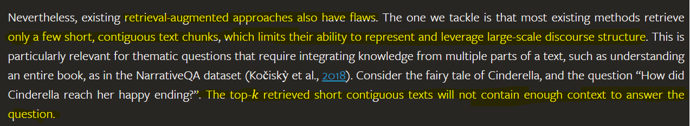
The drawbacks of RAG: The Story of Cinderella
RAPTOR: Recursive Abstractive Processing for Tree-Organized Retrieval (arxiv.org)

Slide 33
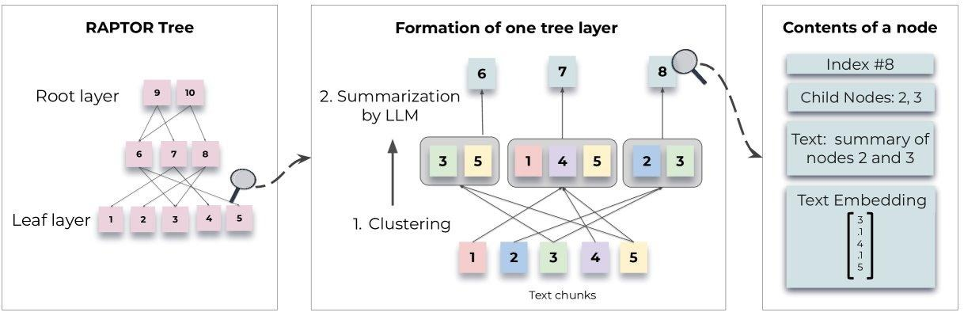
Does this look familiar?
RAPTOR: Recursive Abstractive Processing for Tree-Organized Retrieval (arxiv.org)

Slide 34
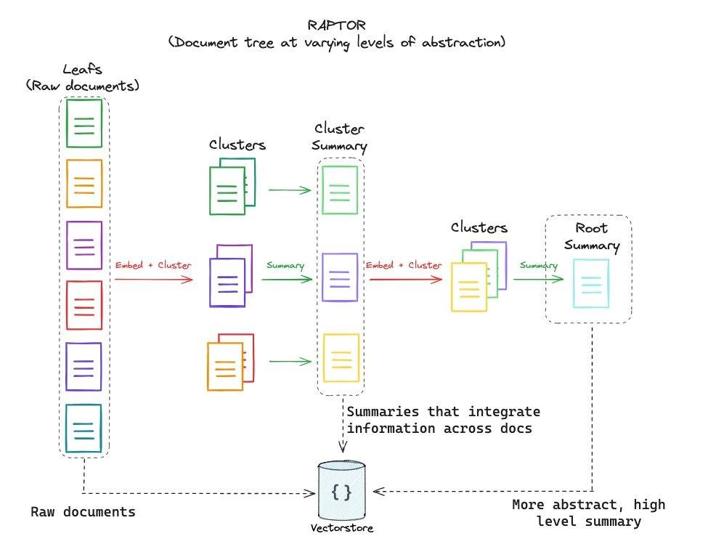

Slide 35
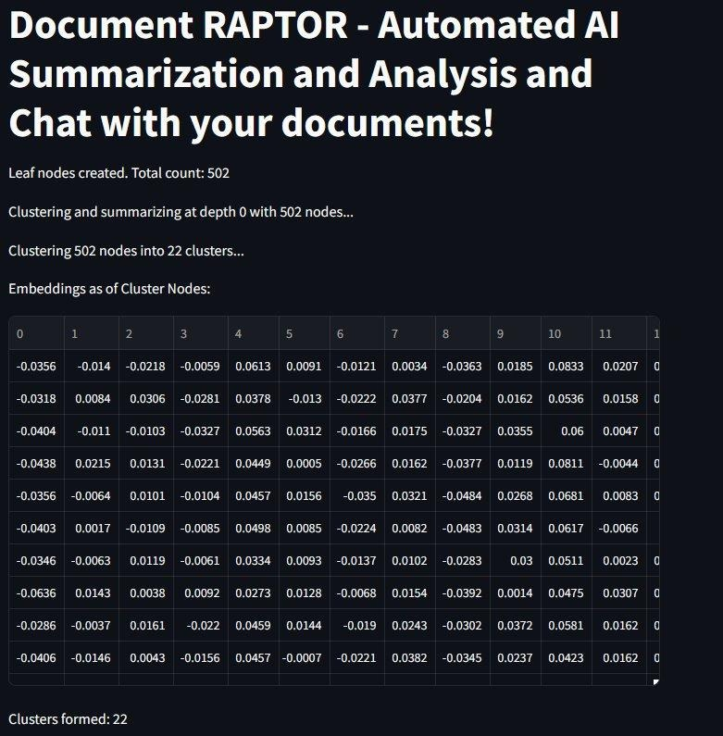
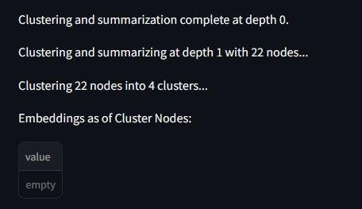
RAPTOR: Recursive Abstractive Processing for Tree-Organized Retrieval (arxiv.org)

Slide 36
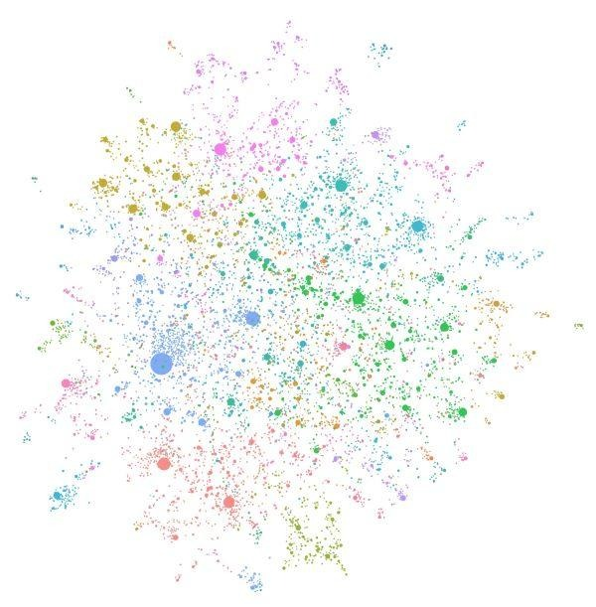
graphRAG

Slide 37
Knowledge Graphs
Baseline RAG struggles to connect the dots. This happens when answering a question requires traversing disparate pieces of information through their shared attributes in order to provide new synthesized insights.
Baseline RAG performs poorly when being asked to holistically understand summarized semantic concepts over large data collections or even singular large documents.
The LLM processes the entire private dataset, creating references to all entities and relationships within the source data, which are then used to create an LLM-generated knowledge graph.
This graph is then used to create a bottom-up clustering that organizes the data hierarchically into semantic clusters (indicated by using color in Figure 3 below). This partitioning allows for pre-summarization of semantic concepts and themes, which aids in holistic understanding of the dataset.
At query time, both of these structures are used to provide materials for the LLM context window when answering a question.

Slide 38
*** WARNING *** PROCEED WITH CAUTION

Slide 39
graphRAG is *very* expensive
As you can imagine these graphs are huge and require a lot of computational and GPU power.
I abandoned my first attempt at GraphRAG after the job / bill reached about $65 – and it wasn't even close to being finished
Local models (LLMs) via tools like Ollama can ease the costs but they will still take substantial amount of time to generate locally unless you have serious GPU access
Be careful with cloud models when trying to build Knowledge Graphs

Slide 40
TAG: Table Augmented Retrieval

Slide 41
Beyond Text2SQL
Tabular data is already organized; structured; and can be queried with Structured Query Language (SQL)
Attempts to move to Text2SQL still cumbersome
LLM and a similar approach as RAG lets up lookup Tabular data in a similar way

Slide 42
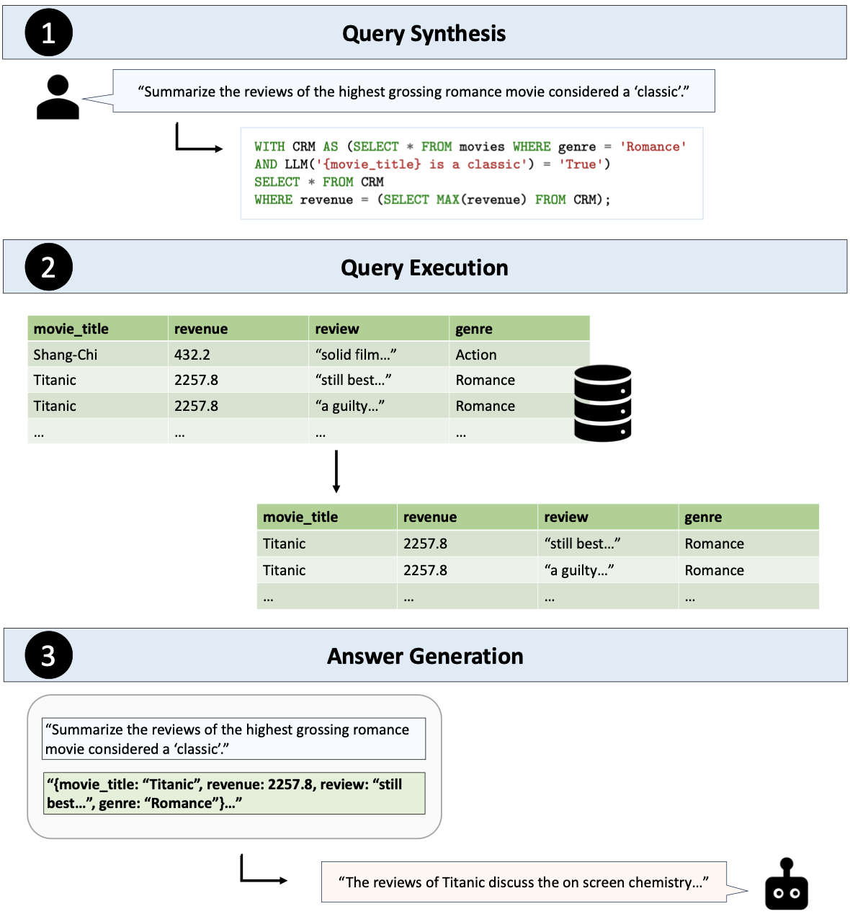
[2408.14717] Text2SQL is Not Enough: Unifying AI and Databases with TAG

Slide 43
RAFT: Retrieval Augmented Fine-Tuning

Slide 44
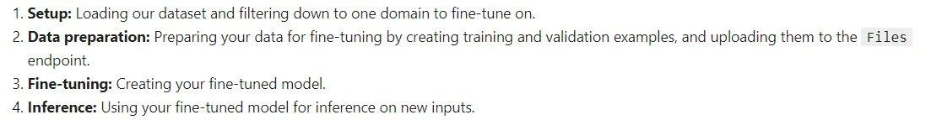
Fine-Tuning
Fine-tuning is the process of taking a pre-trained machine learning model and further training it on a smaller, targeted, domain-specific, data set. The aim of fine-tuning is to maintain the original capabilities of a pretrained model while adapting it to suit more specialized use cases.

Slide 45
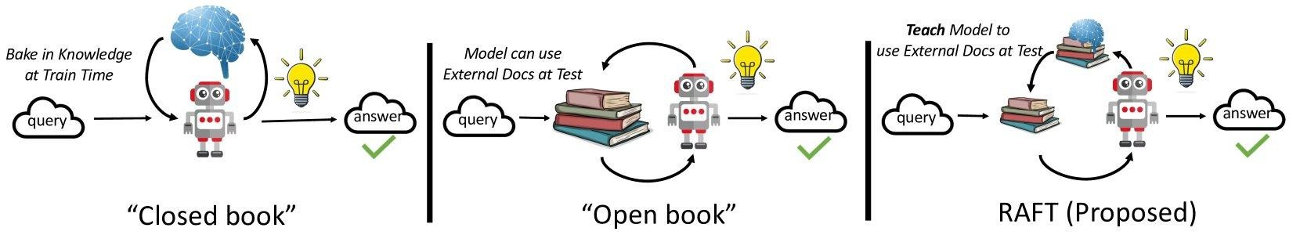
We can, recursively, use RAG to Fine Tune
RAFT: Adapting Language Model to Domain Specific RAG (arxiv.org) RAFT (Retrieval Augmented Fine-tuning): A new way to teach LLMs (Large Language Models) to be better at RAG (Retrieval Augmented Generation) (microsoft.com)

Slide 46
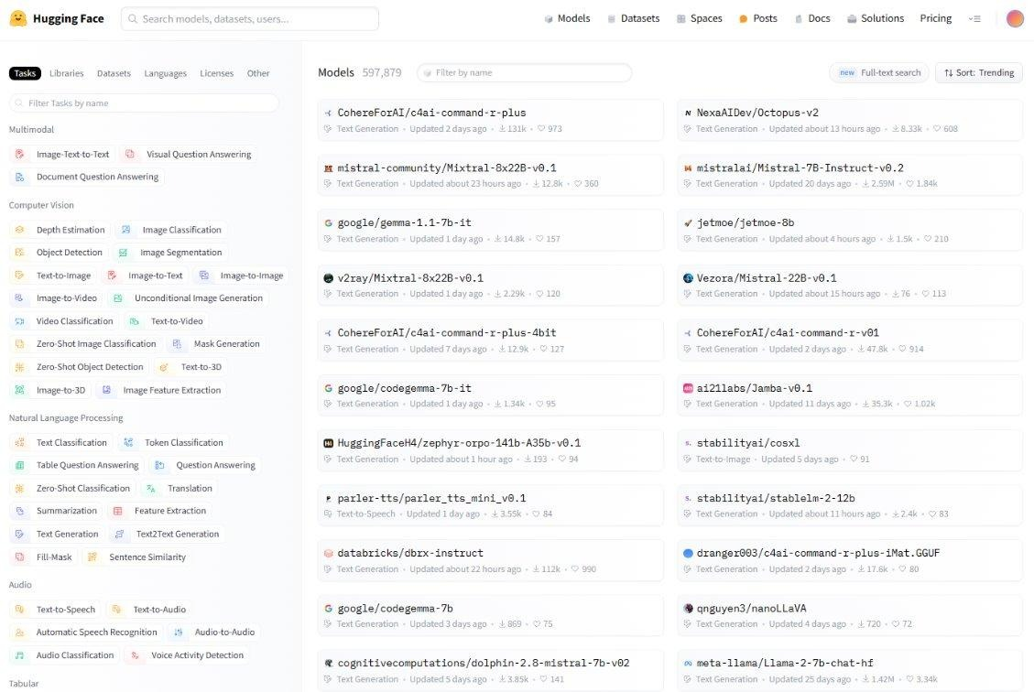
HuggingFace: GitHub for Models

Slide 47
Agentic RAG

Slide 48
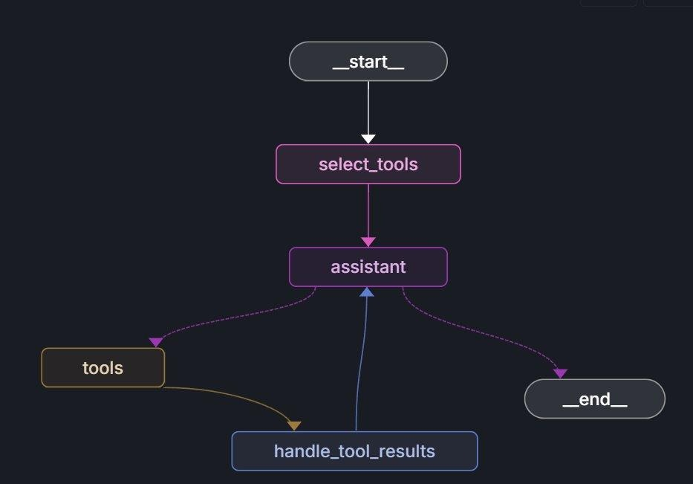
RAG

Slide 49
Resources:
Buddies (Basic RAG) – Document, Packet automateyournetwork/Document_Buddy: Chat with various documents - XLSX, DOCX, PPTX, CSV, PDF, TXT - using chatGPT 4 Turbo and Langchain automateyournetwork/packet_buddy: pcap analysis provided by chatGPT4 Turbo RAPTORs – Document, Packet automateyournetwork/Document_RAPTOR: A RAPTOR Tree of your documents used for Language Model Retrieval to chat with the documents! automateyournetwork/packet_raptor: An AI Assistant using RAPTOR to talk to .pcaps Knowledge Graphs (GraphRAG) - Document, Packet automateyournetwork/Document_graphRAG: graphRAG approach with .pcap automateyournetwork/packet_graph: A Knowledge Graph of a .pcap Packet Capture! TAG - Packet automateyournetwork/Packet_TAG: Table Augmented Generation (TAG) with Packet Captures (.pcaps/pcapng)

Slide 50
Before we do the RAG Labs … I have good news …. and bad news

Slide 51
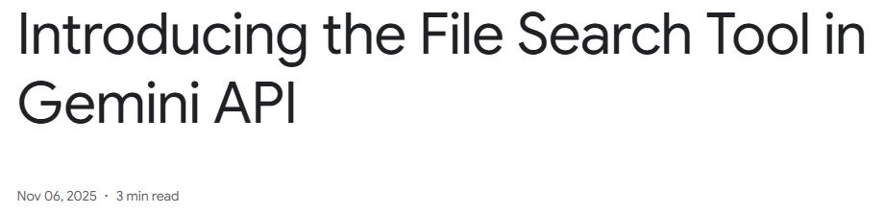
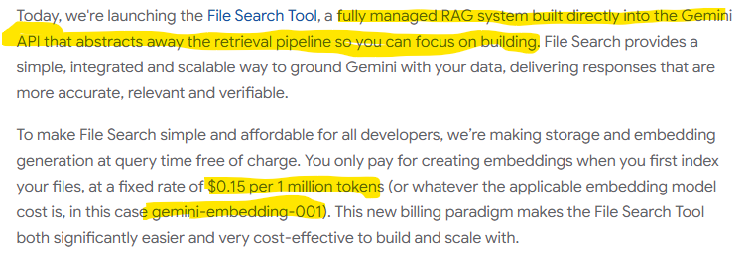
RAGaaS

Slide 52
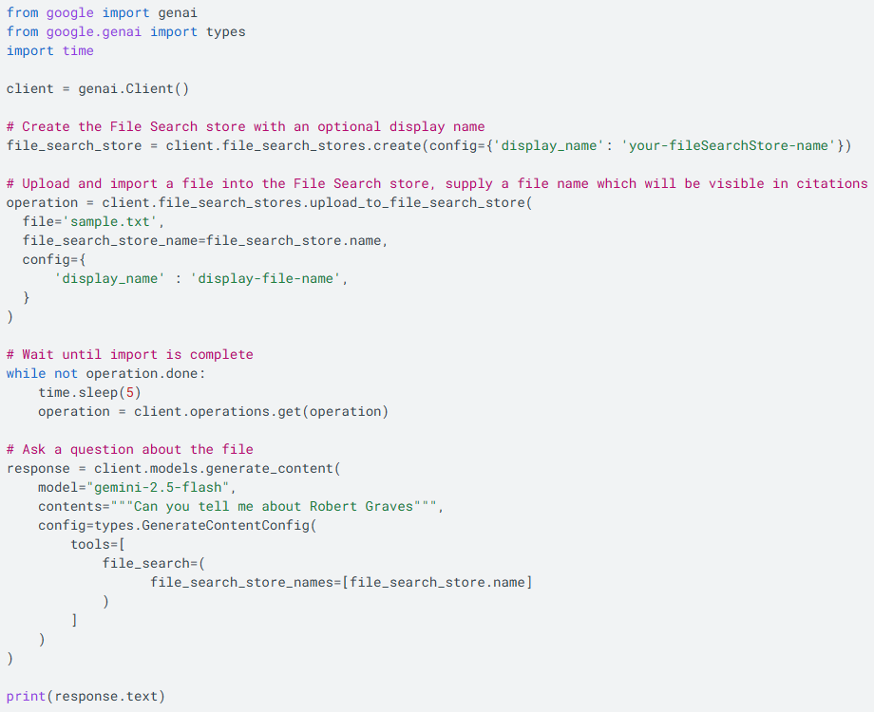

Slide 53
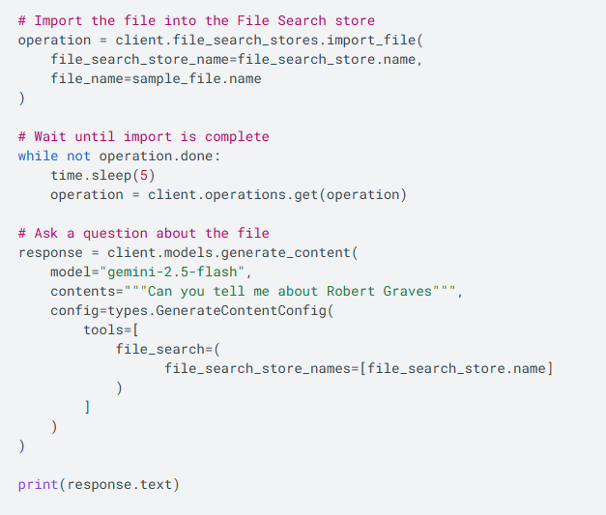

Slide 54
TOON: Token-Oriented Object Notation

Slide 55
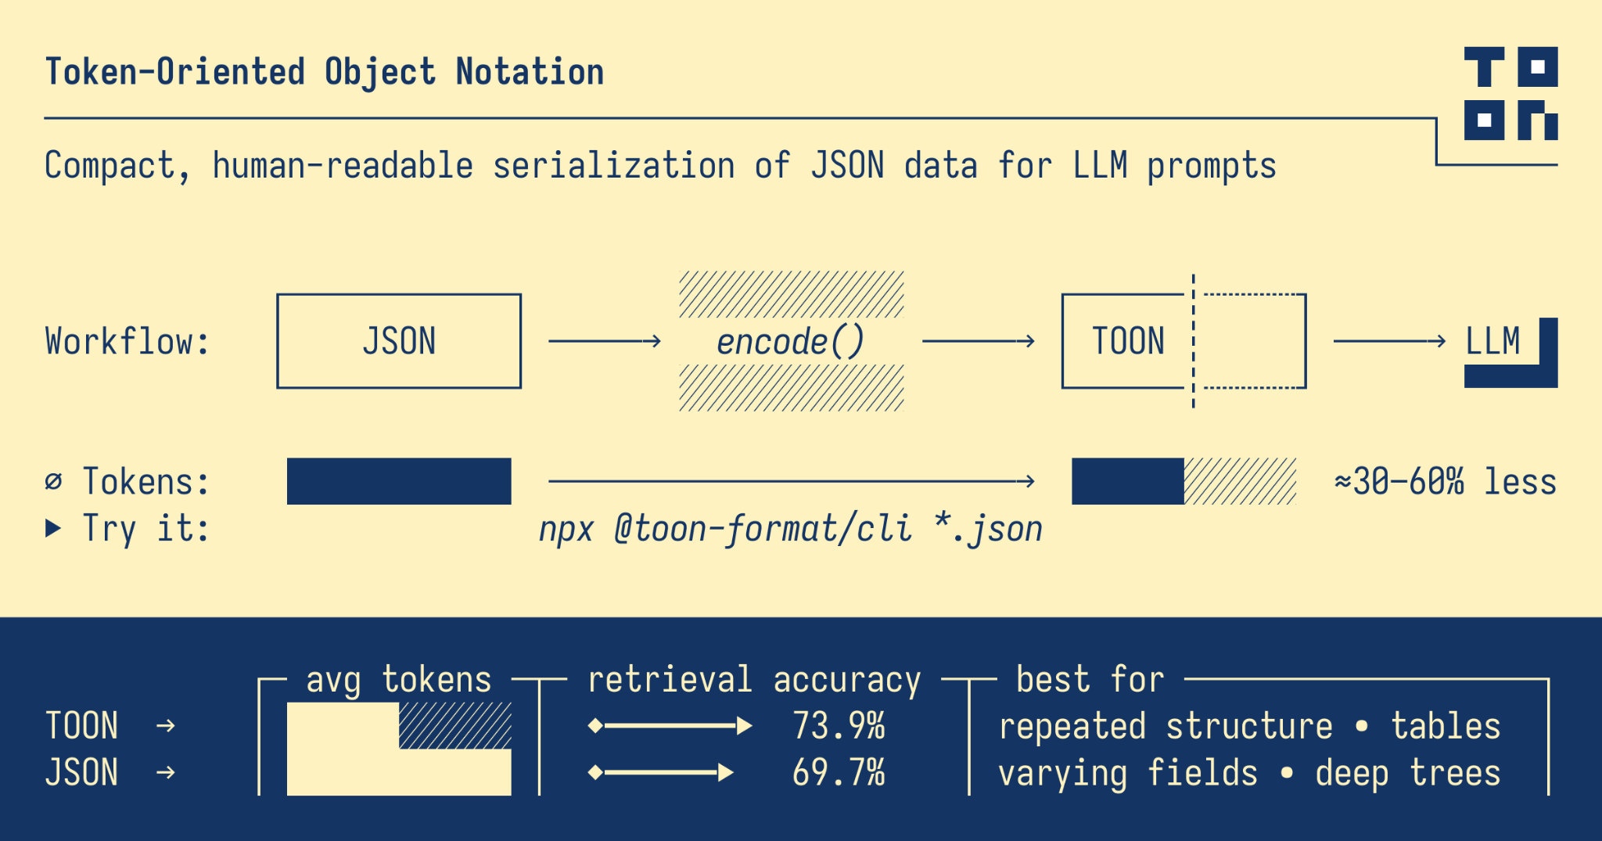

Slide 56
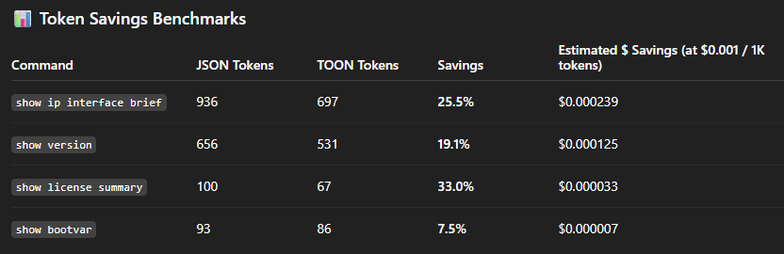

Slide 57
Questions?

Slide 58
RAG Lab Agenda

Slide 59
Lab One – Exploration
Embeddings
Splitting
Storage
Lab Two – Talk to PDFs
LLM
Embeddings Model
Source
Loader
Semantic Chunking
Storage
Retrieval
PDF Buddy
Lab Three – Talk to Networks
Cisco pyATS
Cisco DevNet Always On Sandbox
Chat with Interfaces
6 step process
JSON -> TOON
Router Buddy

Slide 60
Git Clone this Repo and follow the README.md automateyournetwork/NANON96_Workshop: From RAG to MCP You should have received an email with an openAI API Key as well as DevNet Sandbox credentails

Slide 61
Model Context Protocol (MCP): Protocols in the Age of AI: A Cambrian Period of Innovation

Slide 62
The Impact of Protocols
Remember or try to imagine society before ….
Simple Mail Transfer Protocol (SMTP) E-mail clients E-mail servers
HyperText Transfer Protocol (HTTP) Web browsers Web servers
Various routing protocols
Static routing

Slide 63
What is Model Context Protocol?
The "USB-C" of Artificial Intelligence
Say it backwards – A Protocol that provides Context to the Model
Anthropic released in November 2024 since donated to Linux Foundation
Over 20k MCP Servers already available
Embraced Universally by Microsoft, Google, openAI, GitHub, AWS
Added to the new CCNP: Automation track

Slide 64
What is Model Context Protocol?
The "USB-C" of Artificial Intelligence
MCP Server can be anything from a REST API abstraction (common), a database, a Python script; almost anything!
Client / Server Architecture
JSON RPC 2.0 Discovery mechanism – clients discover the tools a server offers
Natural Language is the foundation

Slide 65
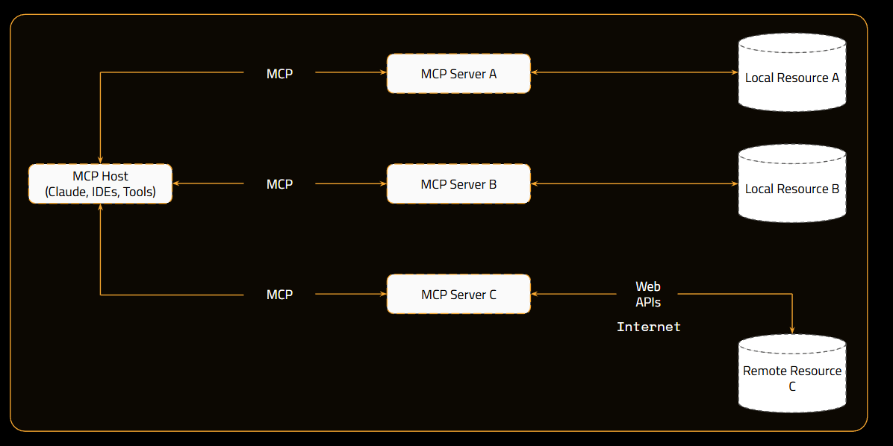

Slide 66
FastMCP – Build an MCP in seconds
from mcp.server.fastmcp import FastMCP
mcp = FastMCP("pyATS Network Automation Server") @mcp.tool()
async def pyats_run_show_command()
<logic>
mcp.run()
Servers can be run locally as stdio mode or remotely hosted such as Itential (remote, secure, streaming servers)

Slide 67
Clients; clients everywhere
VS Code Microsoft Copilot
Claude Desktop
Gemini-CLI
Custom AI Agents

Slide 68
Questions?

Slide 69
MCP Lab Agenda

Slide 70
Lab One – Exploration
Multiplication MCP
Lab Two – Subnet Calculator
Lab Three – pyATS MCP
Lab Four – Free exploration time – add your MCPs to MCP clients like VS Code Copilot and more!

Slide 71
Thank you
01-JAN-2020

